Slide 1
The FAST Gauss Transform
MATH 191 Final Presentation
By Group III
Akua Agyapong, Adrian Ilie, Jameson Miller,
Eli Rosen, Nikolay Stoynov

Slide 2
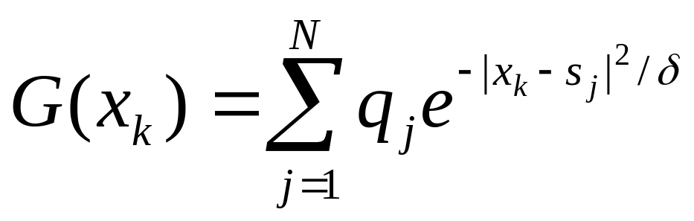
Discrete Gauss Transform
Target locations
δ=1
Weight coefficients
Source locations

Slide 3
Direct Gauss Transform
s_{N}
. . .
. . .
s_{i}
. . .
. . .
. . .
. . .
. . .
s₁
x₁
x₂
x₃
x₄
. . .
x_{i}
. . .
x_{M}
Naïve solution: O(NM)

Slide 4
Direct Gauss Transform
Simple, but slow algorithm
Pseudo code:
targets[] - array of target points
results[] - array of values at target points
sources[] - array of source points
weights[] - array of weights associated with source points
for(int i = 0; i < numTargetPoints; i++) {
results[i] = 0;
for(int j = 0; j < numSourcePoints; j++){
results[i] += weights[j]* e^(targets[i] - sources[j])
}
}

Slide 5
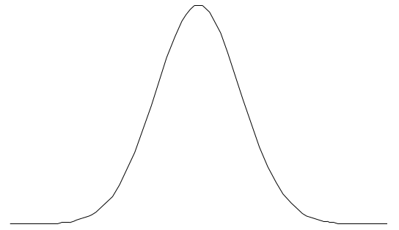
Fast Gauss Transform
Less costly algorithm using
Numerical Approximation:
P
i p x
2
π
∑
C
e
L
p
p
=
−
P
e
−
x
2
≈
0
L
Interval Length and Number of Coefficients?

Slide 6

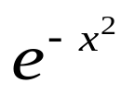
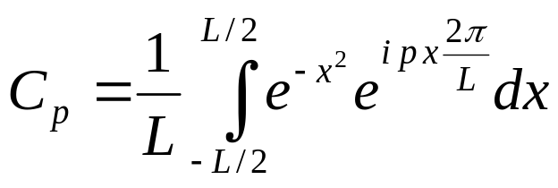
Gaussian
Approximation
  Determine interval length, L
    Error =
Fourier Series (smooth, periodic function)
  Calculate coefficients
  Optimal number of terms
    Determined by excluding extremely small Fourier coefficients
    P=20

Slide 7
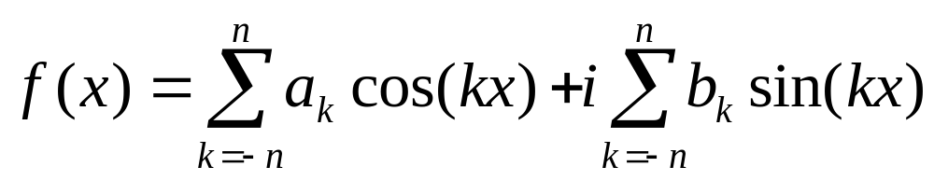
Evaluation of Fourier Series (1)
The result of the evaluation of a Fourier Series is a complex number
  C++ has a complex number template in the STL
    Supplies correct implementation of addition, multiplication and other algebraic operations
    No conjugate member function

Slide 8
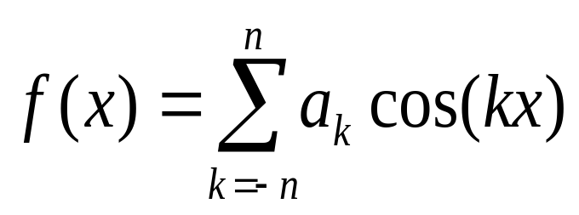
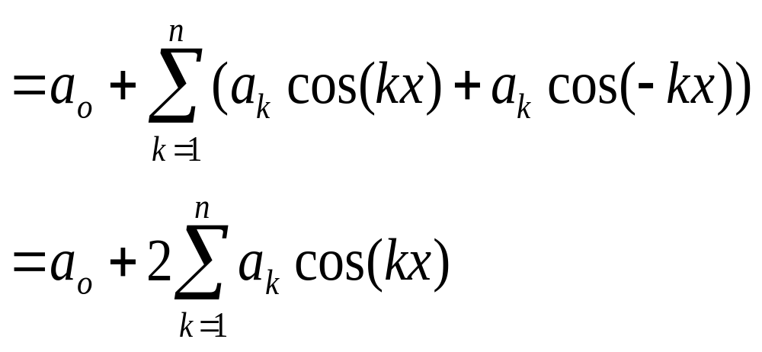
Evaluation of Fourier Series (2)
Since the Gaussian is an even function, the imaginary part drops out
a_{i} = a_{-i ,} so we can combine them into one step

Slide 9
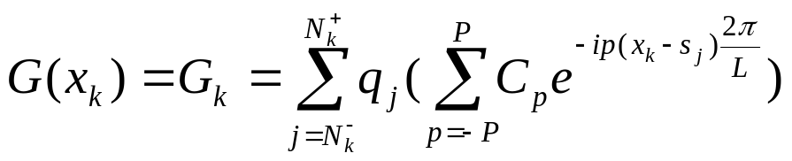
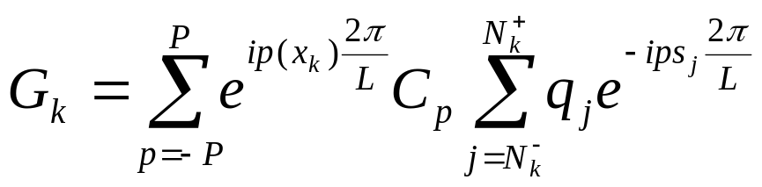
Fast Gauss Transform
Implementation:
Rearrangement:
W_{p}^{k}

Slide 10
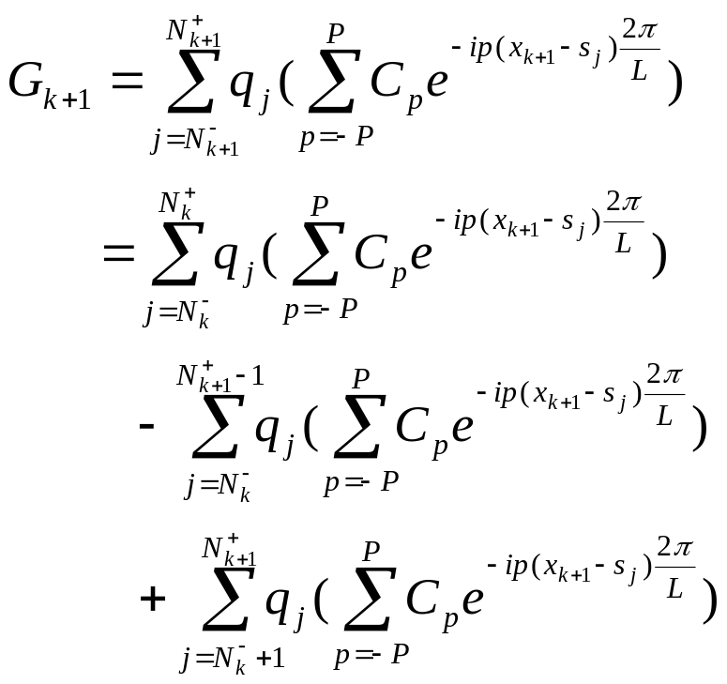
Recursion
Index shift:
W_{p}^{k}
W_{p-}^{k+1}
W_{p+}^{k+1}

Slide 11
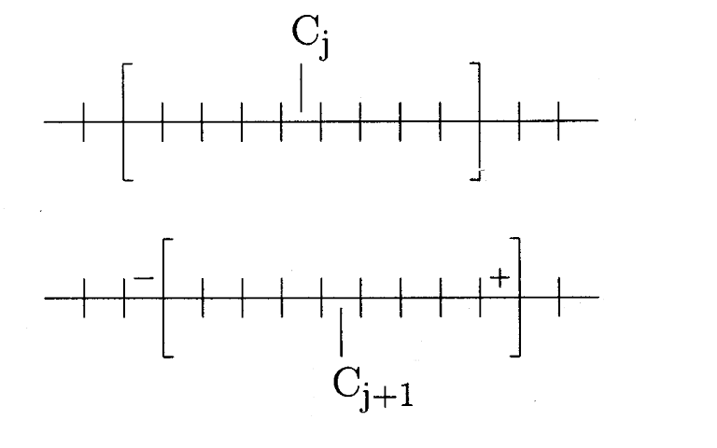
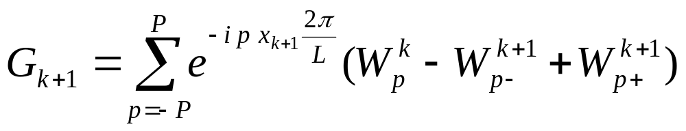
Sliding the evaluation window
inf _{k}
sup _{k}
x_{k}
inf _{k+1}
sup _{k+1}
x_{k+1}
Already calculated directly

Slide 12
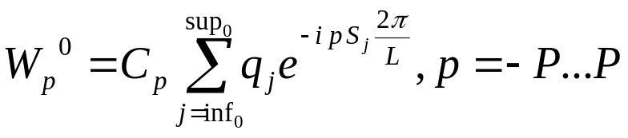
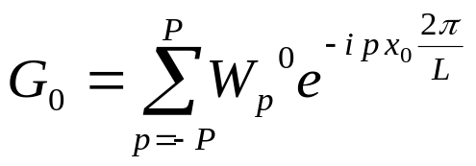
Algorithm – initial phase
Determine inf₀ and sup₀
Compute
Compute
Total Work: O(1)

Slide 13
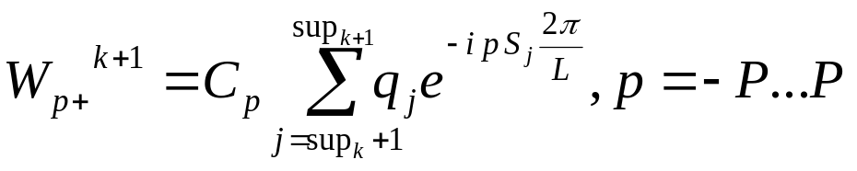
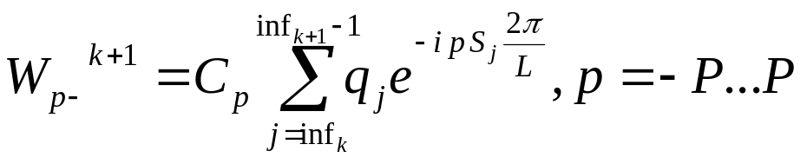
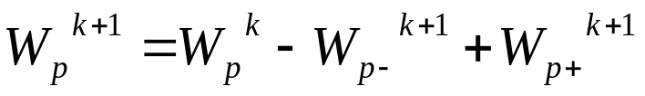
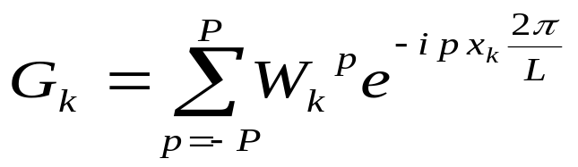
Algorithm – loop phase, i=1..N
Advance inf_{k} and sup_{k} to inf_{k+1} and sup_{k+1}
Compute
Compute
Compute
Compute
Total Work: O(N)

Slide 14
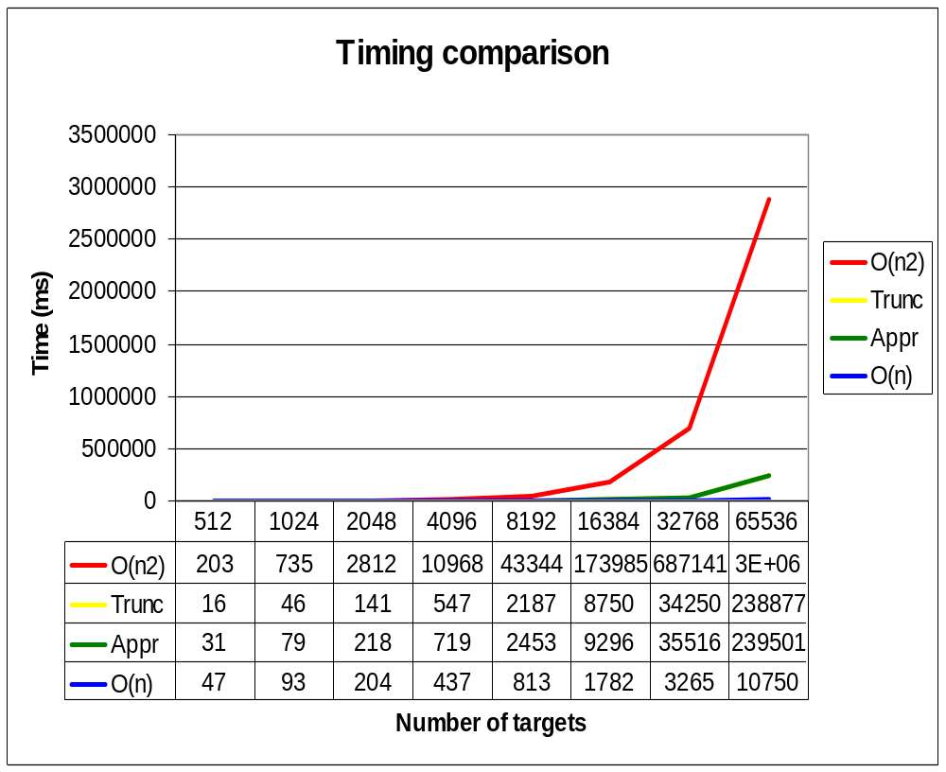
Timing comparison

Slide 15
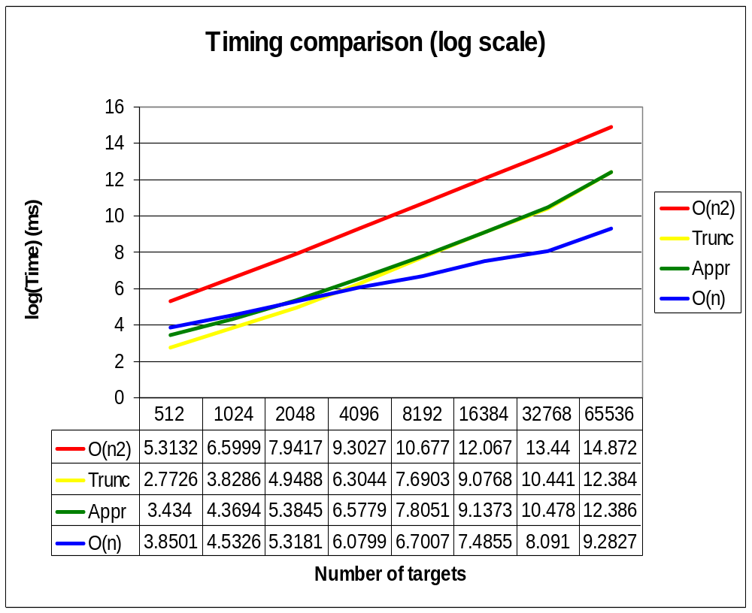
Timing comparison (log scale)

Slide 16
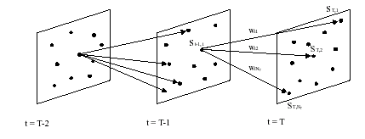
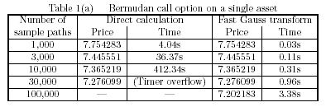
Applications
Option pricing
  Determining optimal selling strategy by sum of Gaussians
Mark Broadie and Yusaku Yamamoto, January 2002

Slide 17
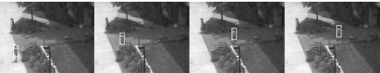
Applications
Color tracking
  Mixture of Gaussians for modeling regions with a mixture of color.
Ahmed Elgammal et al, IEEE,Transactions on Pattern Analysis and Machine Intelligence, November 2003

Slide 18
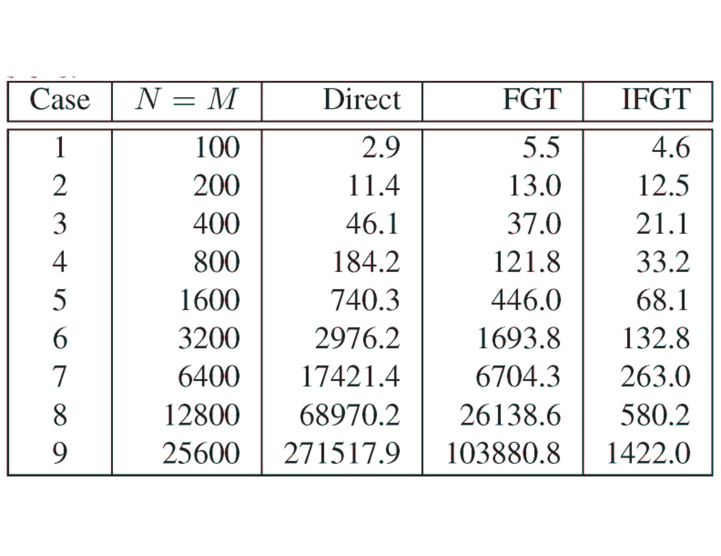
Recent Developments
Improved Fast Gauss Transform
FGT has successfully accelerated the kernel density estimation to linear running time for low dimensional problems. However, the cost of a direct extension of the FGT to higher-dimensional grows exponentially with dimension, making it impractical for dimension above 3.
C. Yang, R. Duraiswami, N. A.. Gumerov and L. Davis – ICCV 2003

